Slide 1
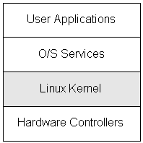
LINUX SUBSYSTEM
Subsystem :
A subsystem is a single, predefined operating environment through which the system coordinates the work flow and resource use.
The Linux operating system is composed of four major subsystems:

Slide 2
User Applications :
The set of applications in use on a particular Linux system will be different depending on what the computer system is used for, but typical examples include a word-processing application and a web-browser.
O/S Services :
These are services that are typically considered part of the operating system (a windowing system, command shell, etc.); also, the programming interface to the kernel (compiler tool and library) is included in this subsystem.
Linux Kernel :
This is the main area of interest in this paper; the kernel abstracts and mediates access to the hardware resources, including the CPU.
Hardware Controllers :
This subsystem is comprised of all the possible physical devices in a Linux installation; for example, the CPU, memory hardware, hard disks, and network hardware are all members of this subsystem

Slide 3
INTRODUCTION TO KERNAL
KERNAL :
The kernel is a computer program that is the core of a computer's operating system, with complete control over everything in the system.
LINUX KERNAL:
A kernel is the lowest level of easily replaceable software that interfaces with the hardware in your computer. It is responsible for interfacing all of your applications that are running in “user mode” down to the physical hardware, and allowing processes, known as servers, to get information from each other using inter-process communication (IPC).

Slide 4
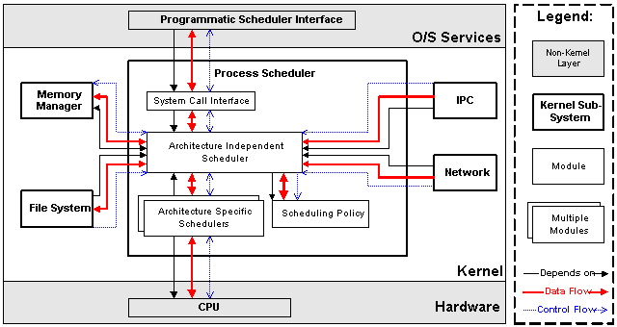
KERNAL SUBSYSTEM
Process Schedulers (SCHED):
Process scheduling policy module is responsible for judging which process will have access to the CPU; the policy is designed so that processes will have fair access to the CPU.

Slide 5
The scheduler is divided into four main modules:
The scheduling policy module is responsible for judging which process will have access to the CPU; the policy is designed so that processes will have fair access to the CPU.
Architecture-specific modules are designed with a common interface to abstract the details of any particular computer architecture. These modules are responsible for communicating with a CPU to suspend and resume a process. These operations involve knowing what registers and state information need to be preserved for each process and executing the assembly code to effect a suspend or resume operation.
The architecture-independent module communicates with the policy module to determine which process will execute next, then calls the architecture-specific module to resume the appropriate process. In addition, this module calls the memory manager to ensure that the memory hardware is restored properly for the resumed process.
The system call interface module permits user processes access to only those resources that are explicitly exported by the kernel. This limits the dependency of user processes on the kernel to a well-defined interface that rarely changes, despite changes in the implementation of other kernel modules

Slide 6
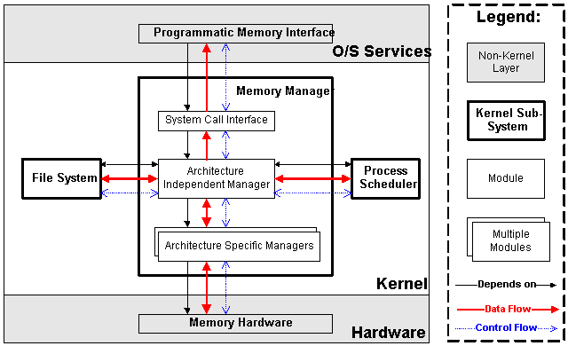
MEMORY MANAGER(MM)
The memory manager subsystem is responsible for controlling process access to the hardware memory resources. This is accomplished through a hardware memory-management system that provides a mapping between process memory references and the machine's physical memory.

Slide 7
The memory manager subsystem is composed of three modules:
The architecture specific module presents a virtual interface to the memory management hardware
The architecture independent manager performs all of the per-process mapping and virtual memory swapping. This module is responsible for determining which memory pages will be evicted when there is a page fault -- there is no separate policy module since it is not expected that this policy will need to change.
A system call interface is provided to provide restricted access to user processes. This interface allows user processes to allocate and free storage, and also to perform memory mapped file I/O.

Slide 8
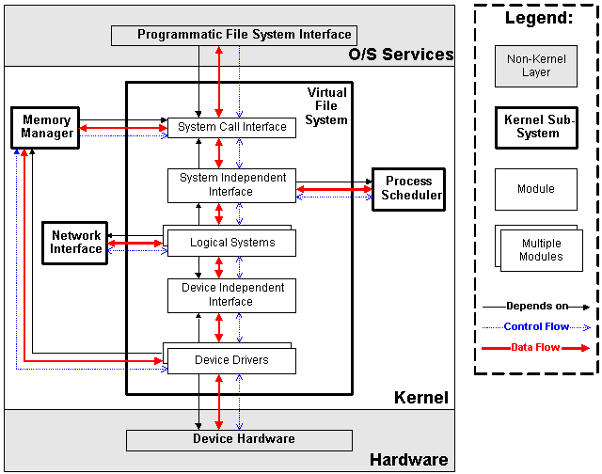
VIRTUAL FILE SYSTEM

Slide 9
VIRTUAL FILE SYSTEM
The virtual file system is designed to present a consistent view of data as stored on hardware devices.
Hardware devices in a computer are represented using a generic device driver interface.
Allows the system administrator to mount any of a set of logical file systems on any physical device. Logical file systems promote compatibility with other operating system standards, and permit developers to implement file systems with different policies.
The virtual file system abstracts the details of both physical device and logical file system, and allows user processes to access files using a common interface, without necessarily knowing what physical or logical system the file resides on.

Slide 10
The Virtual File System subsystem is composed of five modules
There is one device driver module for each supported hardware controller. Since there are a large number of incompatible hardware devices, there are a large number of device drivers. The most common extension of a Linux system is the addition of a new device driver.
The Device Independent Interface module provides a consistent view of all devices.
There is one logical file system module for each supported file system.
The system independent interface presents a hardware and logical-file-system independent view of the hardware resources. This module presents all resources using either a block-oriented or character-oriented file interface.
Finally, the system call interface provides controlled access to the file system for user processes. The virtual file system exports only specific functionality to user processes.

Slide 11
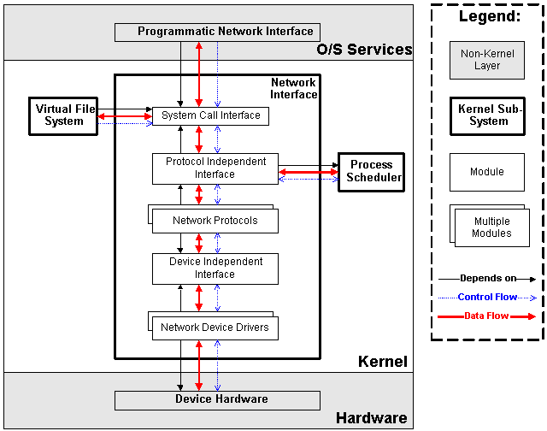
NETWORK INTERFACE
The network subsystem allows Linux systems to connect to other systems over a network. There are a number of possible hardware devices that are supported, and a number of network protocols that can be used. The network subsystem abstracts both of these implementation details so that user processes and other kernel subsystems can access the network without necessarily knowing what physical devices or protocol is being used.

Slide 12
Network device drivers communicate with the hardware devices. There is one device driver module for each possible hardware device.
The device independent interface module provides a consistent view of all of the hardware devices so that higher levels in the subsystem don't need specific knowledge of the hardware in use.
The network protocol modules are responsible for implementing each of the possible network transport protocols.
The protocol independent interface module provides an interface that is independent of hardware devices and network protocol. This is the interface module that is used by other kernel subsystems to access the network without having a dependency on particular protocols or hardware.
Finally, the system calls interface module restricts the exported routines that user processes can access.

Slide 13
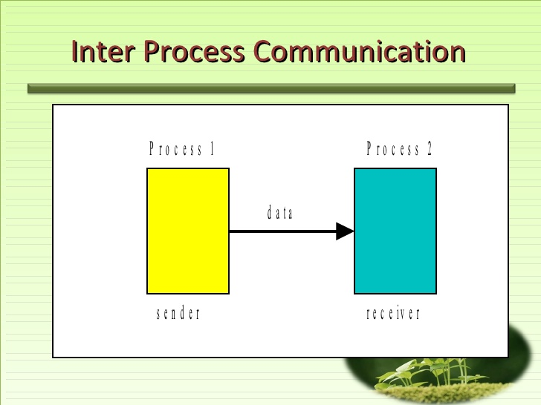
INTER-PROCESS COMMUNICATION
Inter-Process-Communication (or IPC for short) are mechanisms provided by the kernel to allow processes to communicate with each other. On modern systems, IPCs form the web that bind together each process within a large scale software architecture.

Slide 14
The Linux kernel provides the following IPC mechanisms:
Signals
Anonymous Pipes
Named Pipes or FIFOs
SysV Message Queues
POSIX Message Queues
SysV Shared memory
POSIX Shared memory
SysV semaphores
POSIX semaphores
FUTEX locks
File-backed and anonymous shared memory using mmap
UNIX Domain Sockets
Netlink Sockets
Network Sockets
Inotify mechanisms
FUSE subsystem
D-Bus subsystem

Slide 15
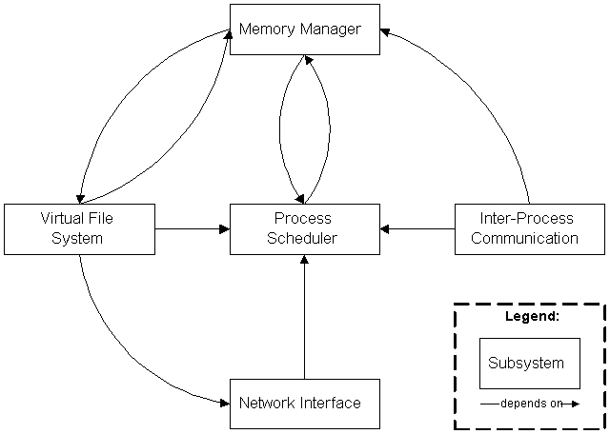
COMMUNICATION BETWEEN SUBSYSTEM

Slide 16
COMMUNICATION BETWEEN SUBSYSTEM
The process-scheduler subsystem uses the memory manager to adjust the hardware memory map for a specific process when that process is resumed.
The inter-process communication subsystem depends on the memory manager to support a shared-memory communication mechanism. This mechanism allows two processes to access an area of common memory in addition to their usual private memory.
The virtual file system uses the network interface to support a network file system (NFS), and also uses the memory manager to provide a ram disk device.
The memory manager uses the virtual file system to support swapping; this is the only reason that the memory manager depends on the process scheduler. When a process accesses memory that is currently swapped out, the memory manager makes a request to the file system to fetch the memory from persistent storage, and suspends the process.

